Slide 1
iTPU
Linear, Ridge and Lasso
Separate models or together? When do we use which?
With real results from the garment factory data
Notes:
This part answers three questions: are these separate models, can we combine them, and which one should we choose?

Slide 2
Together or separate?
Each one is a separate model
For ONE model, you choose ONE method: Linear, Ridge or Lasso.
They predict in the same way (ŷ = X · w). They differ only in how they are TRAINED: which penalty they add to the loss.
In scikit-learn, each one is its own class.
If λ = 0, Ridge and Lasso become plain linear regression.
from sklearn.linear_model import (
LinearRegression, Ridge, Lasso, ElasticNet)
LinearRegression() # no penalty
Ridge(alpha=1.0) # L2 penalty
Lasso(alpha=0.01) # L1 penalty
ElasticNet(alpha=0.01, l1_ratio=0.5)
# both penalties
# in sklearn, alpha = lambda
iTPU
Linear, Ridge, Lasso | together or separate? when to use which
Notes:
One model, one choice. The prediction formula is the same; only the training loss changes.

Slide 3
But...
Three ways to combine them
1. Elastic Net
2. One after another
3. Compare and choose
Both penalties in ONE model:
Lasso's feature selection + Ridge's stability
First Lasso chooses the important features, then Linear or Ridge is trained only on them
Train all of them, compare with cross-validation, keep the best one
(the most common way)
iTPU
Linear, Ridge, Lasso | together or separate? when to use which
Notes:
Three practical ways. The third one is what data scientists do every day.

Slide 4
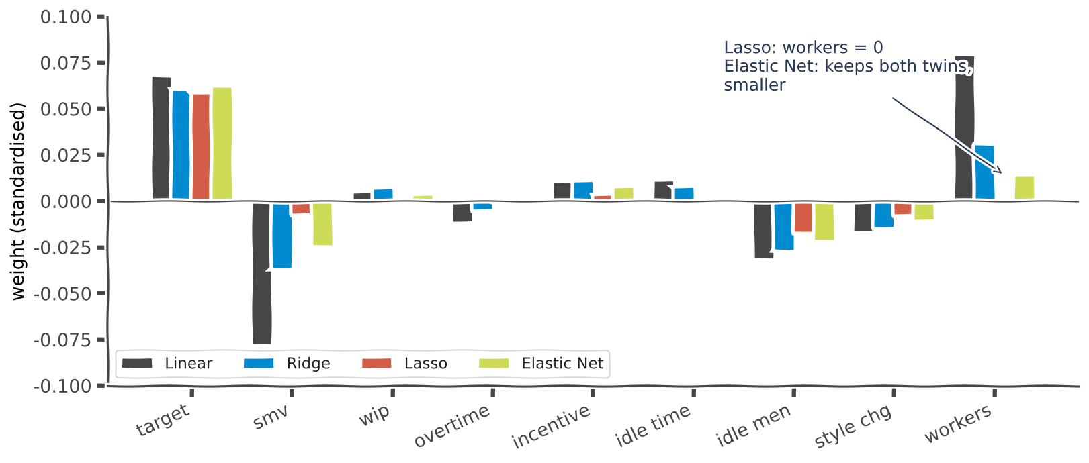
Way 1: Elastic Net
Elastic Net: both penalties in one model
Loss = MSE + λ₁ × Σ |w| + λ₂ × Σ w²
REAL GARMENT RESULT
Lasso keeps 5 features and DROPS workers (= 0)
Elastic Net keeps 8 features and keeps BOTH twins, just smaller: -0.024 / +0.014
Use it when you have MANY features AND twins
Lasso may pick one twin at random; Elastic Net keeps the group
iTPU
Linear, Ridge, Lasso | together or separate? when to use which
Notes:
Elastic Net mixes the two penalties. In sklearn, l1_ratio controls the mix: 1 = pure Lasso, 0 = pure Ridge.

Slide 5
Way 2: one after another
First select with Lasso, then train Linear or Ridge
All 9 features
LASSO
(λ = 0.01)
chooses
5 features
kept
LINEAR
or RIDGE
trained
Features Lasso kept
Result
targeted_productivity
smv
incentive
idle_men
no_of_style_change
Linear on 5 features: test MSE 0.0219
Linear on all 9 features: test MSE 0.0217
Almost the same accuracy with about HALF the features: a simpler model that is easier to explain.
iTPU
Linear, Ridge, Lasso | together or separate? when to use which
Notes:
A very common workflow: Lasso for selection, then a simple model on the chosen features.

Slide 6
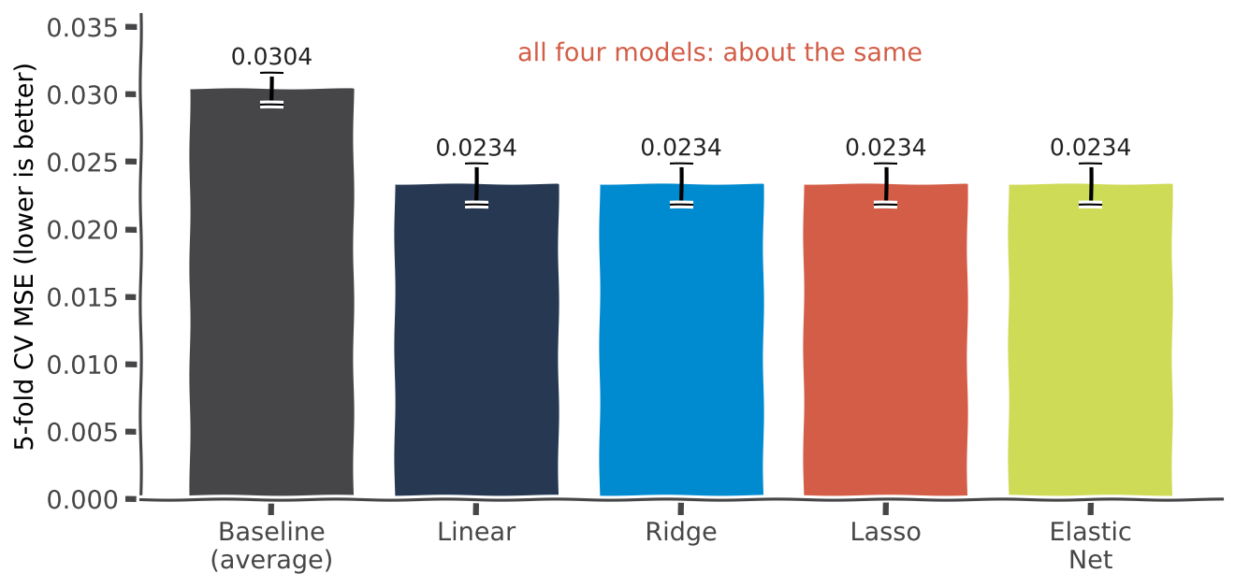
Way 3: compare and choose
Train them all, compare with cross-validation
KEY IDEA
Cross-validation: train and test 5 times on different parts of the data
All four models beat the baseline (0.0304)
On our small data (9 features) they score the SAME: about 0.0234
When scores tie, choose the simplest and most stable model
Remember: the best model is the one that is best on NEW data, not on training data.
iTPU
Linear, Ridge, Lasso | together or separate? when to use which
Notes:
Honest result: with few features, regularization adds stability, not accuracy. With thousands of features, the difference becomes large.

Slide 7
When to use which?
When do we use which model?
Situation
Choose
Why
Few features, independent, no overfitting
Linear
no penalty is needed
Similar features (twins), unstable weights
Ridge
it calms the weights down
Very many features, you need a short list
Lasso
it sets useless weights to 0
Many features AND twins
Elastic Net
both advantages together
More features than examples
Ridge / Lasso
plain linear cannot be solved
iTPU
Linear, Ridge, Lasso | together or separate? when to use which
Notes:
Read the table row by row and ask students for an example of each situation.

Slide 8
Decision guide
A simple decision guide
Is the model overfitting, or are the weights unstable?
NO
LINEAR
regression
Whatever you choose:
standardise the features first
choose λ with cross-validation
check the result on TEST data
compare with the baseline
YES
Do you need a SHORT LIST of features?
NO
RIDGE
YES
NO
YES
Are there twin features among them?
LASSO
ELASTIC NET
iTPU
Linear, Ridge, Lasso | together or separate? when to use which
Notes:
Walk through the questions from top to bottom.

Slide 9
Real life
Real-life examples
House prices
Hospital
Text reviews
Our garment data
Area and number of rooms always grow together: twins.
-> RIDGE
200 patients, 20,000 genes. 'Which few genes matter?'
-> LASSO
5,000 words. 'Which 20 words affect the rating most?'
-> LASSO
Only 9 features, 1,197 rows. Linear works well, but the twins make RIDGE more reliable.
-> LINEAR or RIDGE
iTPU
Linear, Ridge, Lasso | together or separate? when to use which
Notes:
Ask students to add one more example from their own experience.

Slide 10
Always remember
Three rules to always remember
1. Standardise first
2. Never penalise w₀
3. Choose λ with cross-validation
Use StandardScaler before Ridge or Lasso. Otherwise the penalty is unfair.
The intercept only sets the general level. It does not cause overfitting.
RidgeCV, LassoCV. Too small λ = plain linear. Too big λ = underfitting.
iTPU
Linear, Ridge, Lasso | together or separate? when to use which
Notes:
These three rules prevent the most common mistakes.

Slide 11
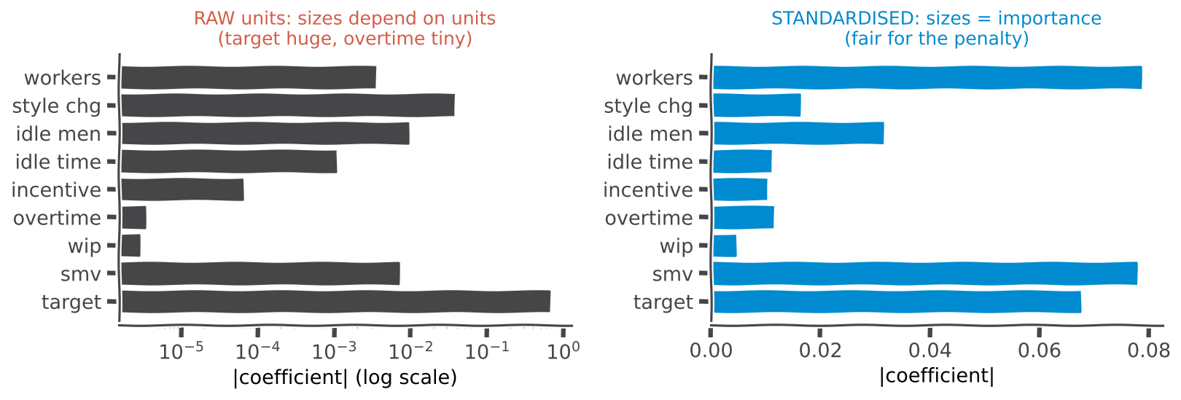
Rule 1
Why we must standardise first
over_time is in minutes (up to 25,920) -> its weight is tiny and escapes the penalty | targeted_productivity is 0 to 0.8 -> its weight is big and is punished unfairly | After standardising, weight size = importance
Remember: a fair penalty needs features on the same scale.
iTPU
Linear, Ridge, Lasso | together or separate? when to use which
Notes:
Left: raw weights reflect units. Right: standardised weights reflect importance.

Slide 12
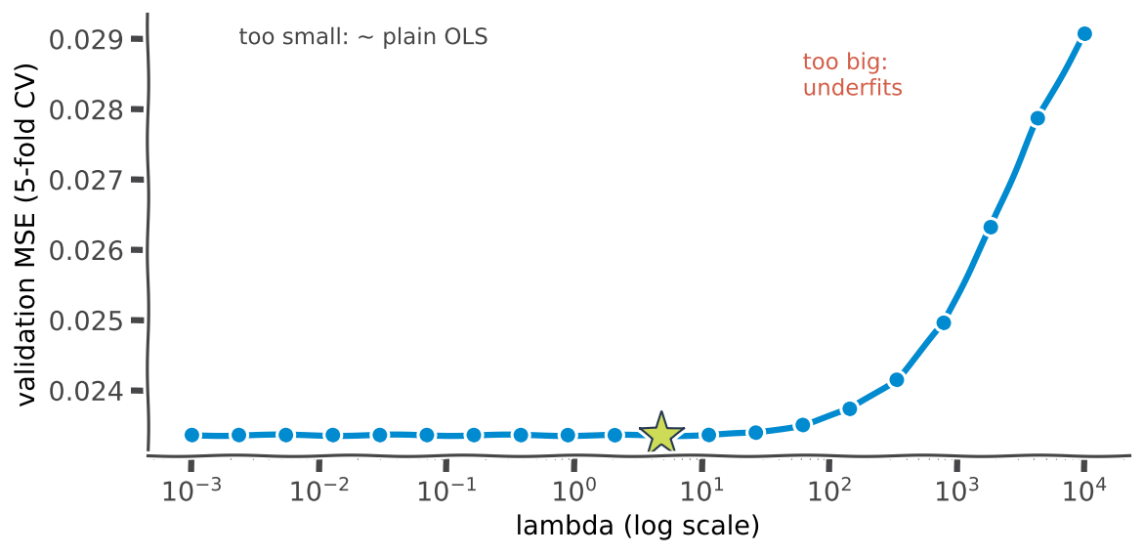
Rule 3
Choose λ with cross-validation
KEY IDEA
Try many λ values and score each one on validation data
Too small: the same as plain linear regression
Too big: underfitting, the error rises
Real best λ on our data: about 5
Remember: λ = 0 turns Ridge and Lasso back into plain linear regression.
iTPU
Linear, Ridge, Lasso | together or separate? when to use which
Notes:
sklearn: RidgeCV(alphas=...), LassoCV(alphas=...) do this automatically.

Slide 13
In one sentence
Ridge and Lasso are linear regression with a penalty: Ridge shrinks all the weights and calms twin features, while Lasso sets useless weights to exactly zero and removes those features. Each one is a separate model, but Elastic Net combines both.
Same prediction ŷ = X · w | different penalty in the loss | choose with cross-validation
Notes:
Read the sentence together with the class.

